Slide 1
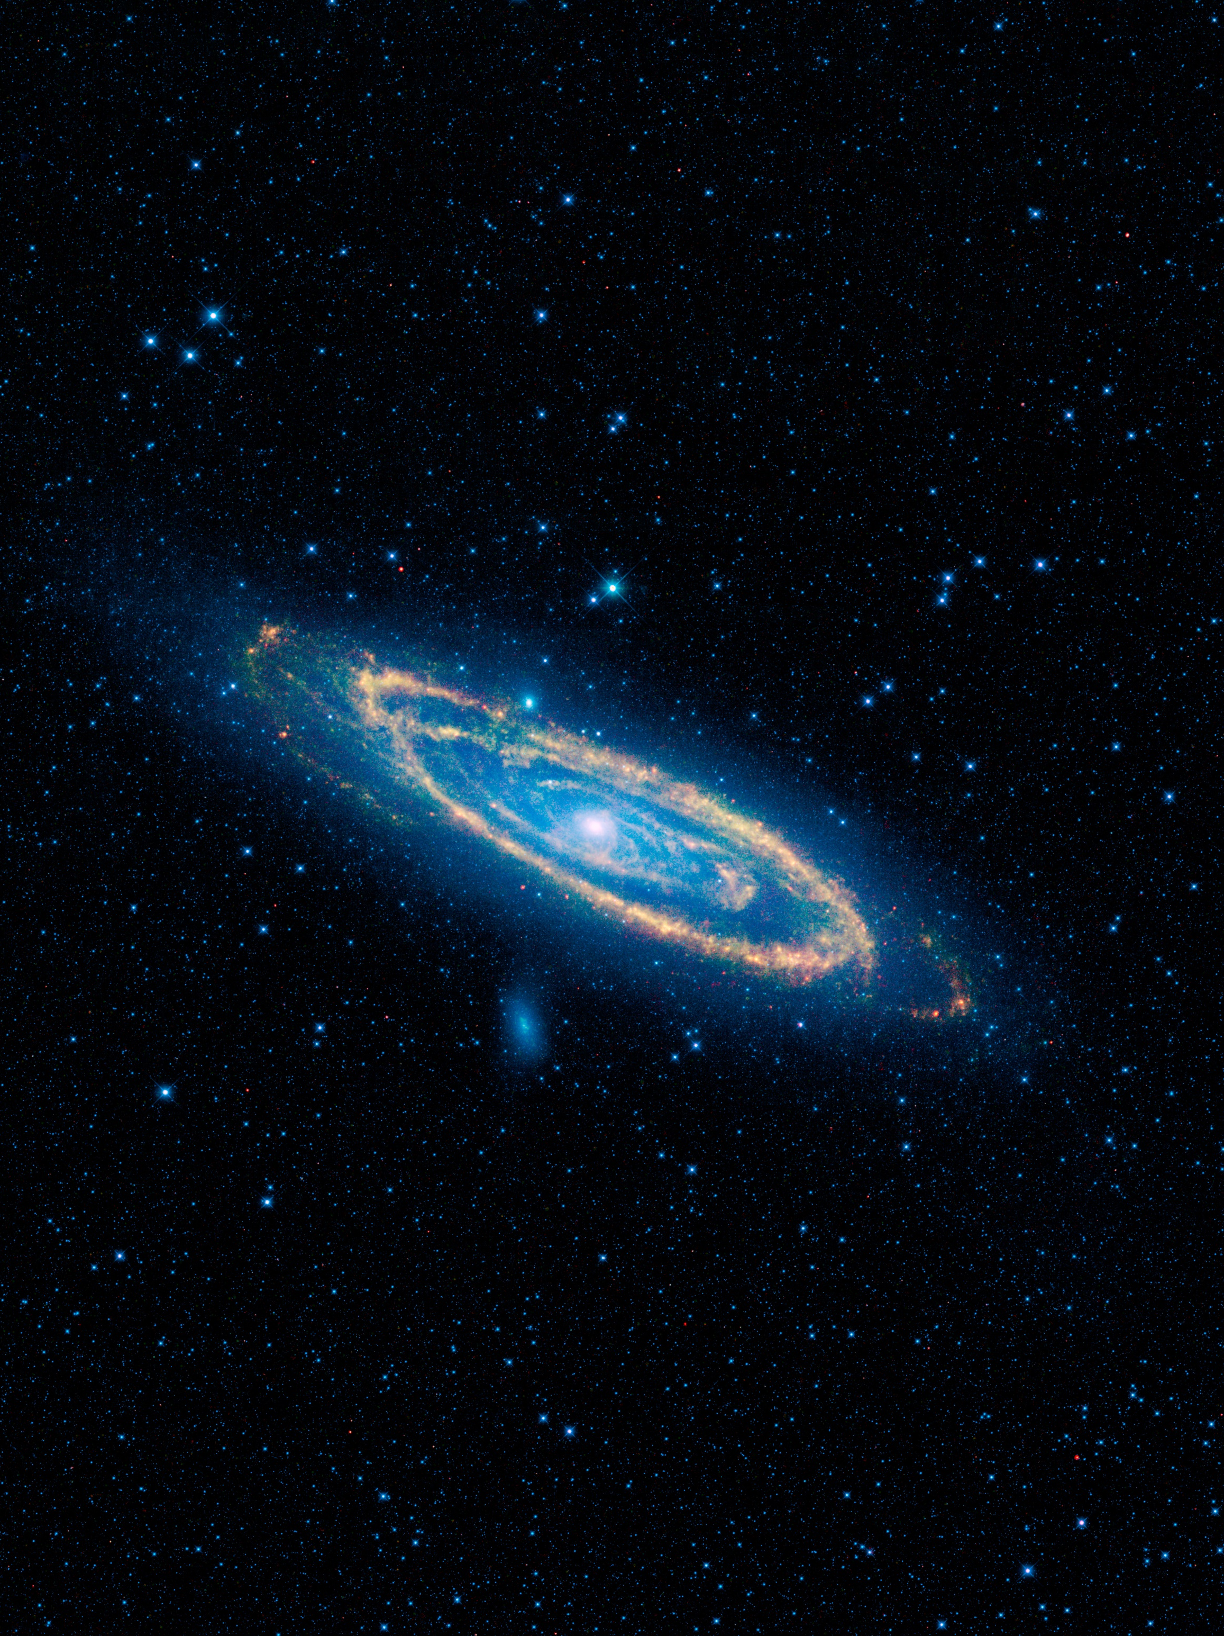
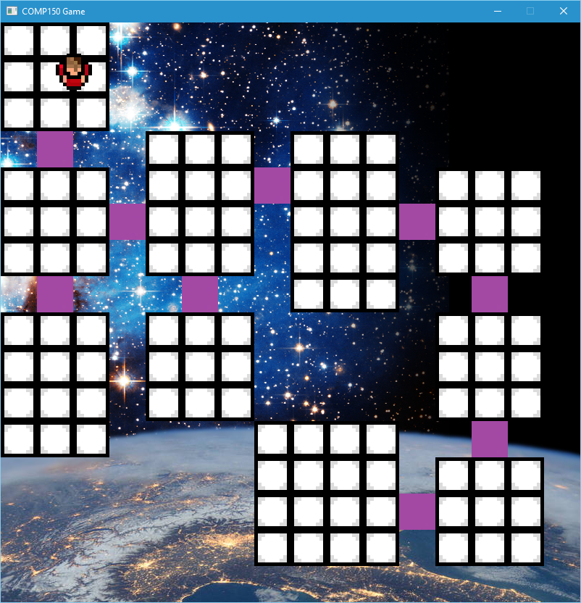
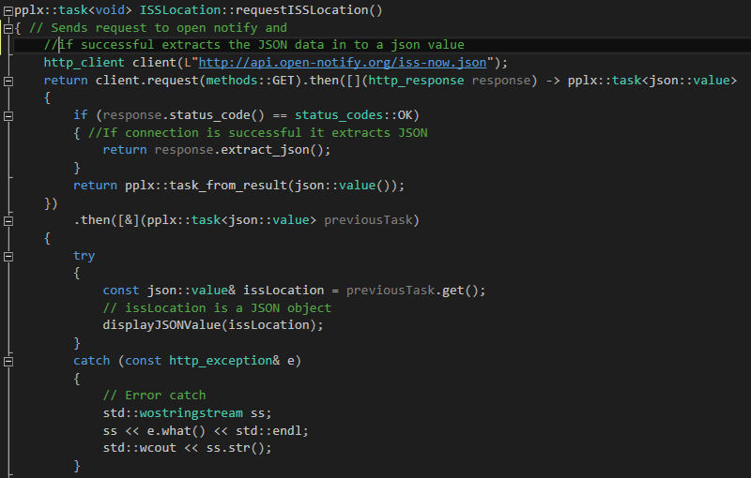
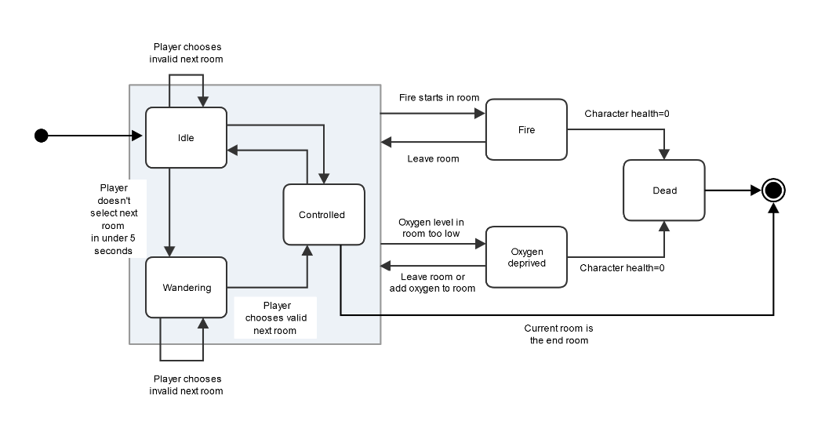
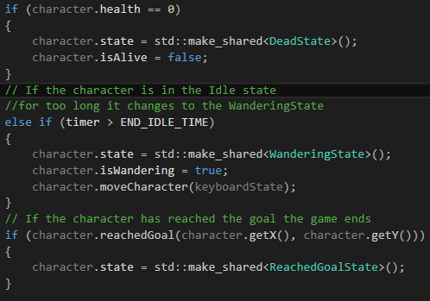
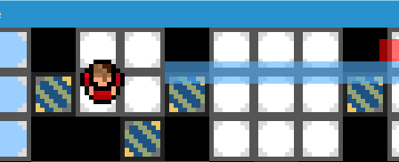
Character AI & Updating Background
Both of the components are integrated into the COMP150 group game. The first is using an API to update the game background based on the location of the ISS. The second is an AI for the character in the game to make it respond to its environment and player input.
Updating Background:
This component uses the Open Notify API to get the location of the International Space Station.
Using JSON and the C++ REST SDK the code extracts the time and the coordinates from the JSON object and moves the background accordingly. The function returns a pplx::task which allows the data to be extracted in the background and not force the program to wait.
Character AI:
The character AI uses the State design pattern to change the characters state depending on the environment. For example if there is low oxygen the character will move slower and lose health.
Each state has an update function that checks the cell the character is on and for player input.

